Slide 1
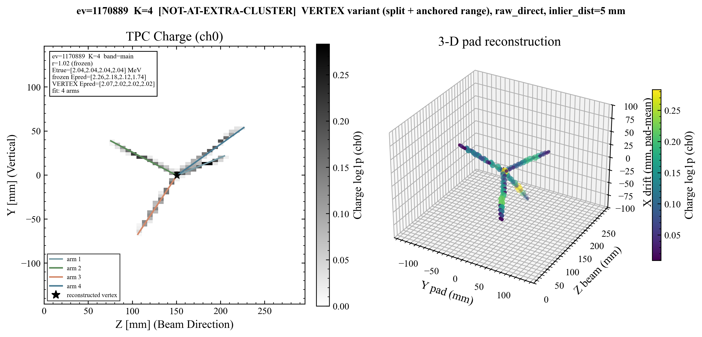
Experiment setup: common image input, two regression routes
Five methods compared on the same image:
Cross-Attention and ResNet predict E directly (without reconstructing tracks at all)
RANSAC, Hough, and Hierarchical Clustering reconstruct the track first, then convert range to energy via SRIM.
Objective: To compare the performance of CNNs with that of traditional algorithms(RANSAC, Hough, and Hierarchical Clustering)
180,000 test events (45000 events per track number)
1-4 alpha tracks per event
truth E ~ U[0.3, 4.0] MeV
E₁ = ?
⍺ source
E₂ = ?
E₃ = ?
E₄ = ?
Energy regression
1 / 10
Notes:
I will briefly introduce the context and the configuration of the new experiment, Previously, we conducted classification and regression studies using an isotropic alpha source, in which the number of tracks ranges from 1 to 4. After successfully determine the track multiplicity and angles for each event, the next step is to perform energy regression to figure out the ability boundary of each approach further. To this end, we will compare 5 approaches: three traditional algorithms, namely Hough, RANSAC, and Hierarchical Cluster, and two ML approaches, namely Standard ResNet and Cross-Attention ResNet.

Slide 2
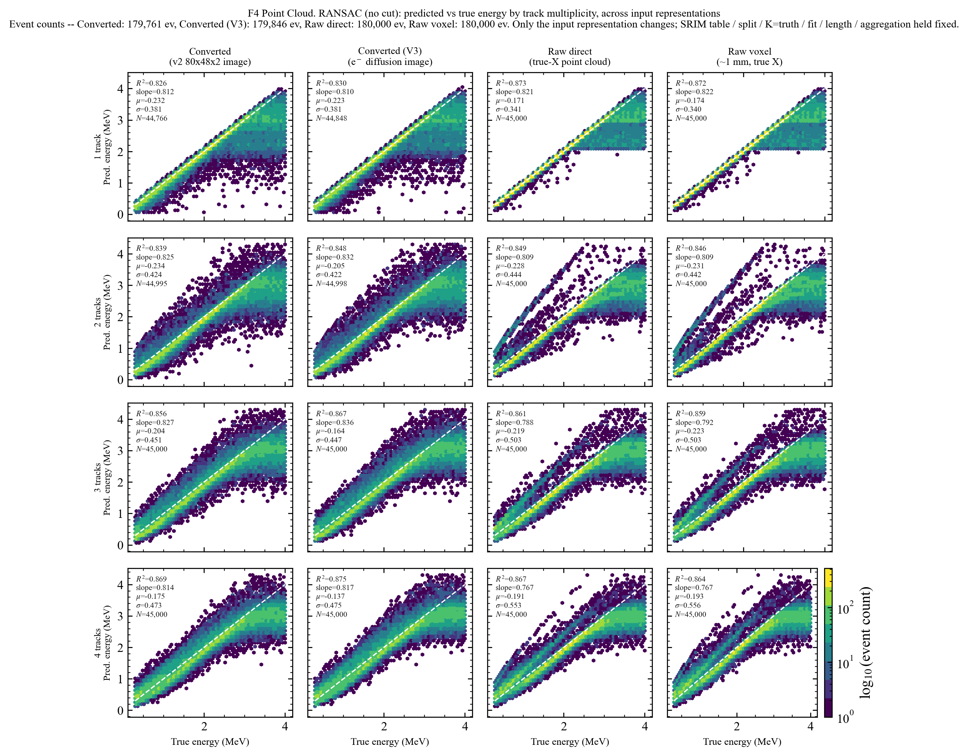
Outline
1. RANSAC Anomaly Investigation and Inference
2. ResNet + Cross Attention Unseen Channel Classification Conclusion
3. Next Steps
CHANNEL | REACTION | ROLE
A · B | ¹²C(α,p) · ¹²C(α,d) | Trained targets
C · D | ¹²C(α,t) · ¹²C(α,³He) | Trained as “other” (clutter)
null | empty detector | Trained as “other”
E | ¹²C(α,⍺) | Unseen — interpolation probe
F · G · H | ¹³C · ¹⁴C · ¹²C elastic | Unseen — far-OOD carbon probes
Energy regression
2 / 10
Notes:
I will briefly introduce the context and the configuration of the new experiment, Previously, we conducted classification and regression studies using an isotropic alpha source, in which the number of tracks ranges from 1 to 4. After successfully determine the track multiplicity and angles for each event, the next step is to perform energy regression to figure out the ability boundary of each approach further. To this end, we will compare 5 approaches: three traditional algorithms, namely Hough, RANSAC, and Hierarchical Cluster, and two ML approaches, namely Standard ResNet and Cross-Attention ResNet.

Slide 3
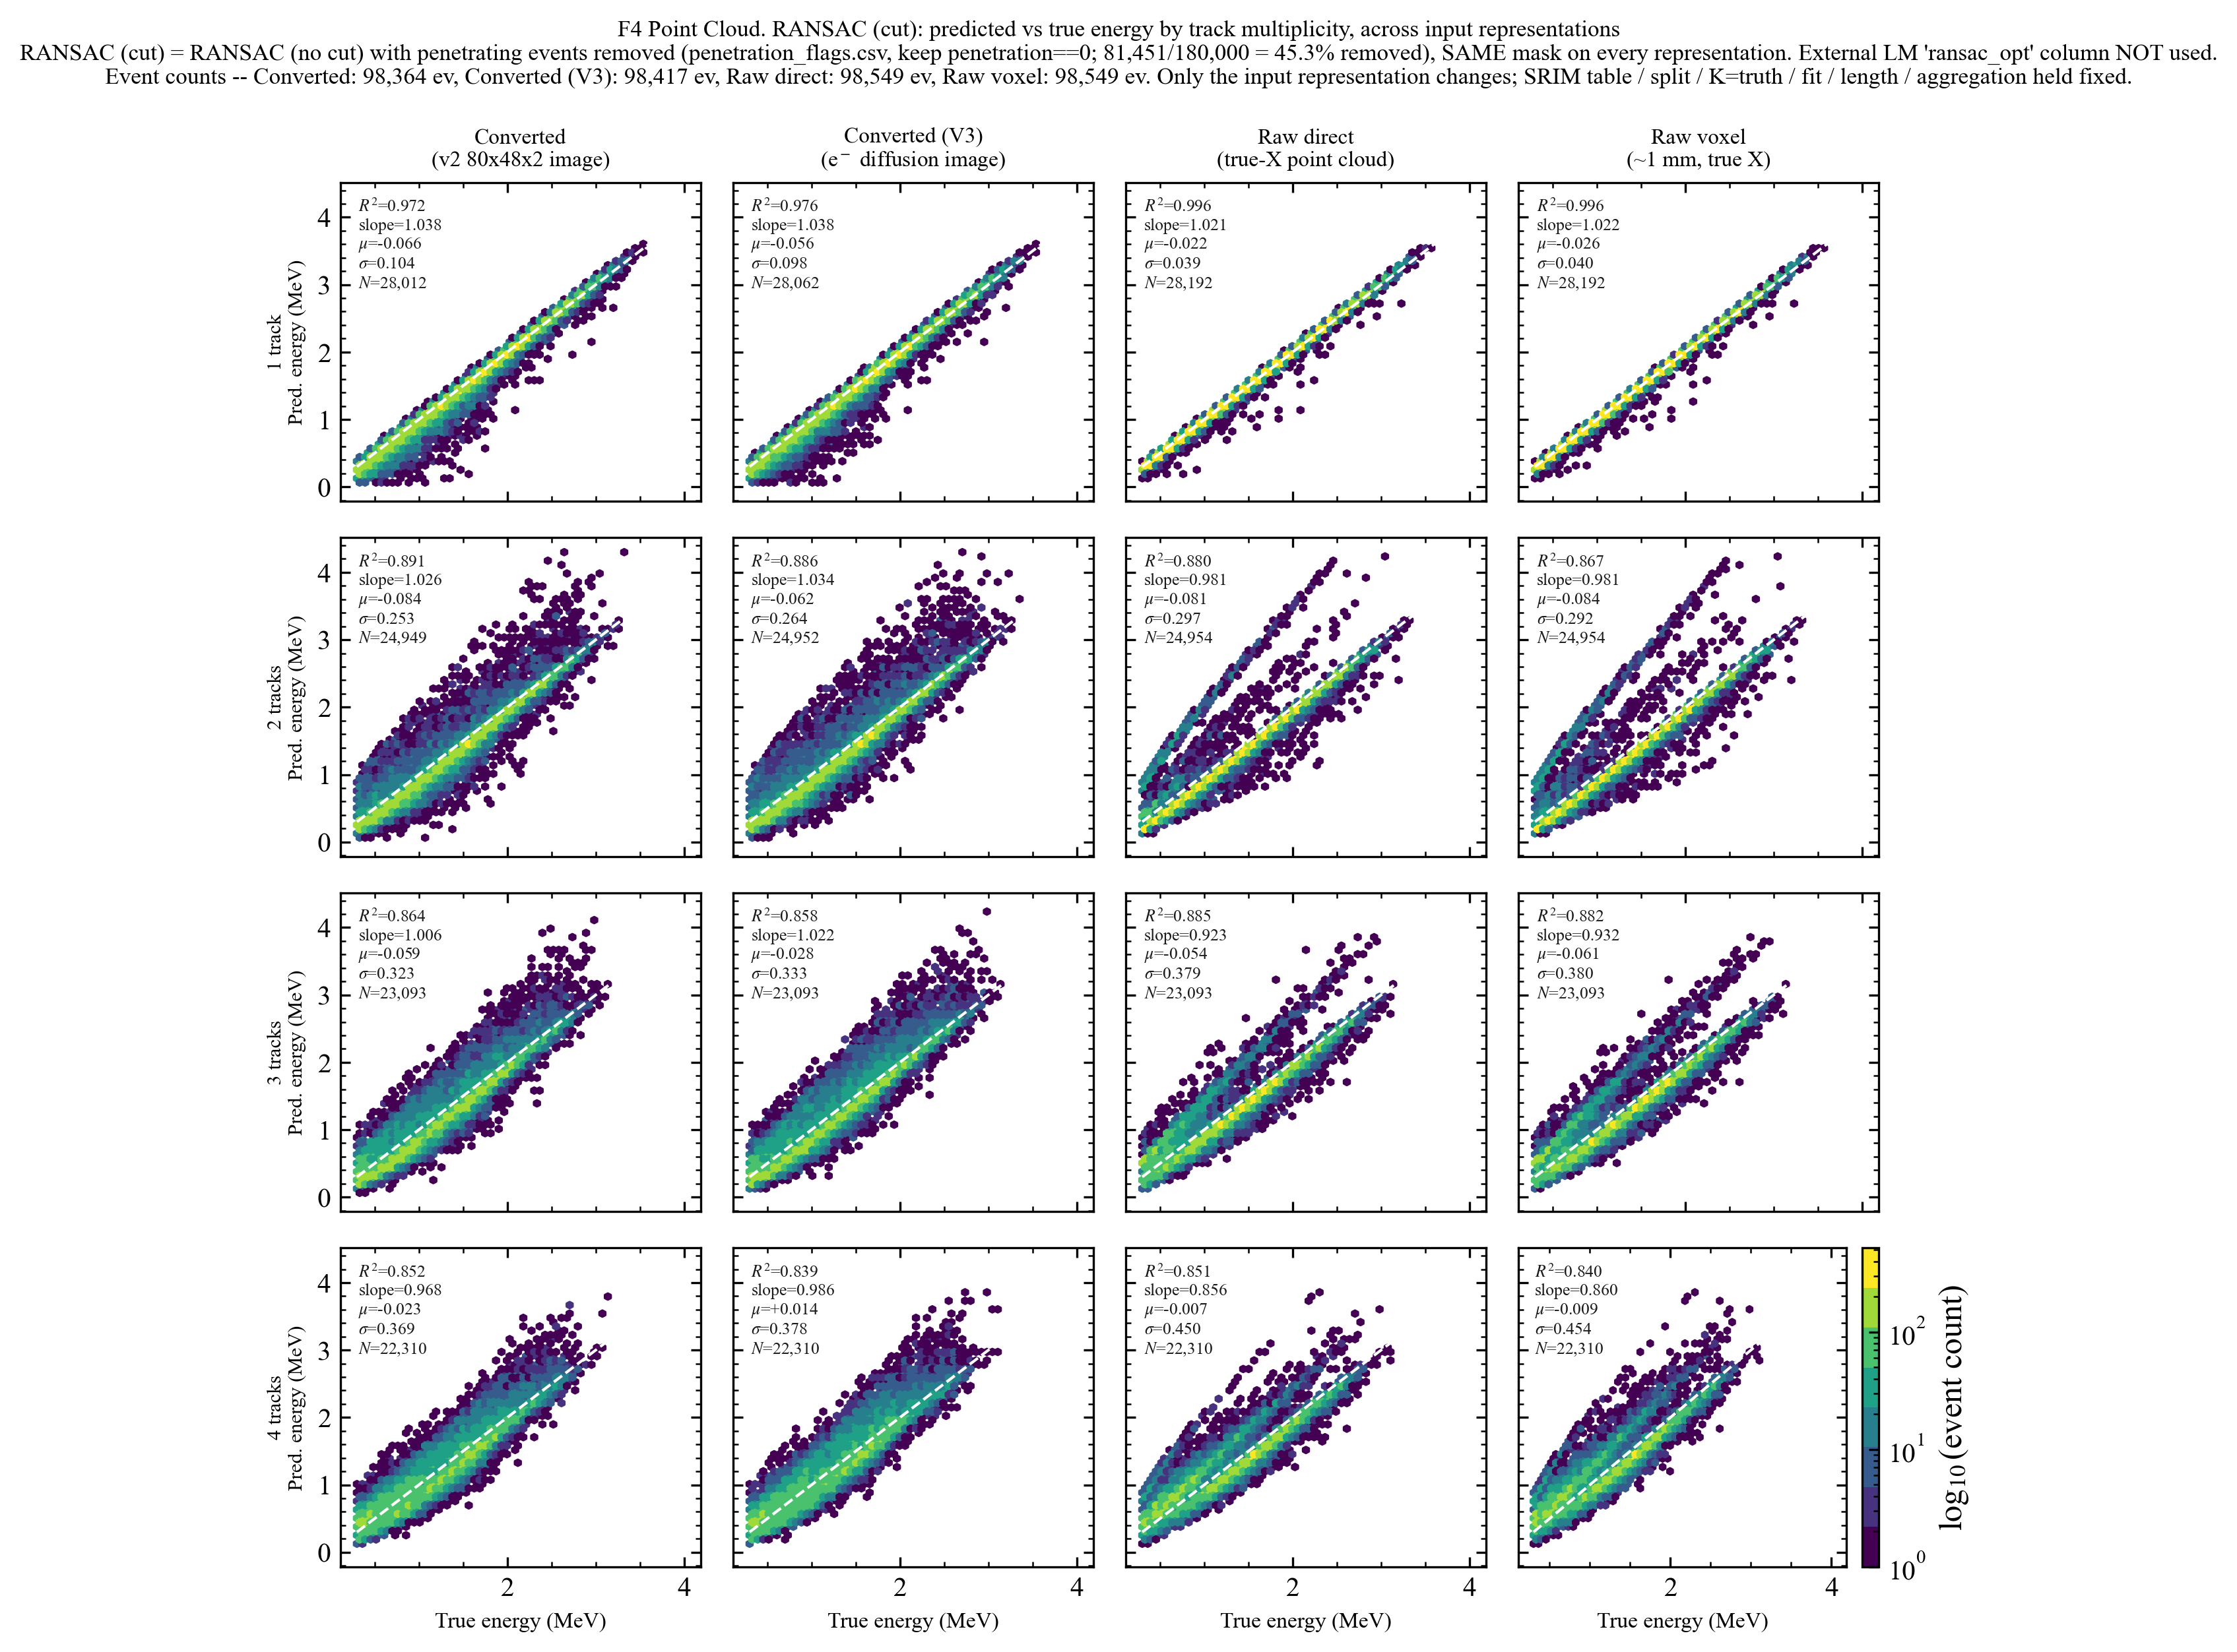
Anomaly in Conventional Methods
Energy regression
3 / 10

Slide 4
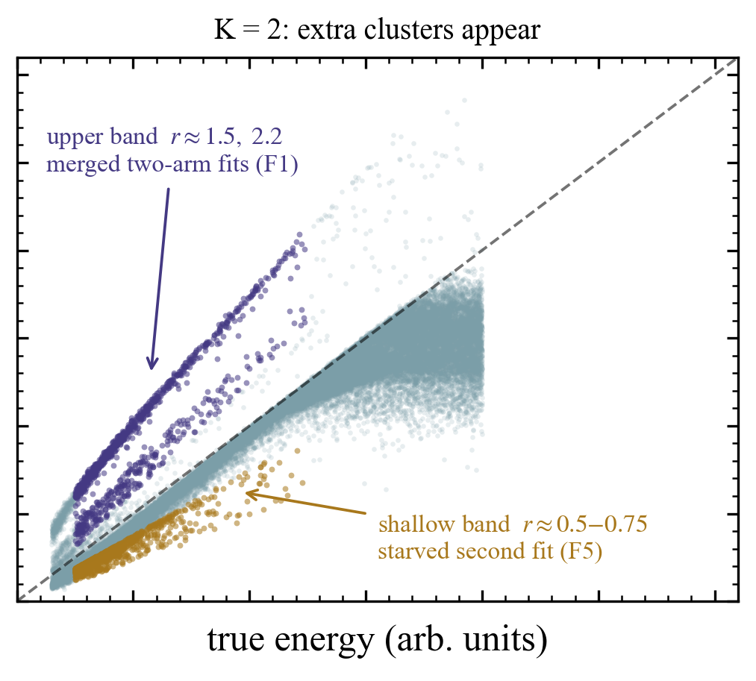
Identify the Anomaly in Conventional Approach Pipeline
1. Raw Hits — MATEROOT platform
2. Converter — 80×48×2 image (MATE resolution)
3. Fit — track fitting and vertex positioning
4. Reconstructed Range — from fit
5. LISE Projection — range→energy (ext.)
Based on the anomaly classification, visualize the events extracted from the upper band and the shallow band
6. Predicted KE — final output
Energy regression
4 / 10
Notes:
This checks whether the gain is only an average effect. The energy-binned plot shows CrossAttention remaining competitive across bins, with the advantage most visible in the low-energy region. The physics caveat is that high-energy tracks are harder because clipping becomes more frequent.

Slide 5
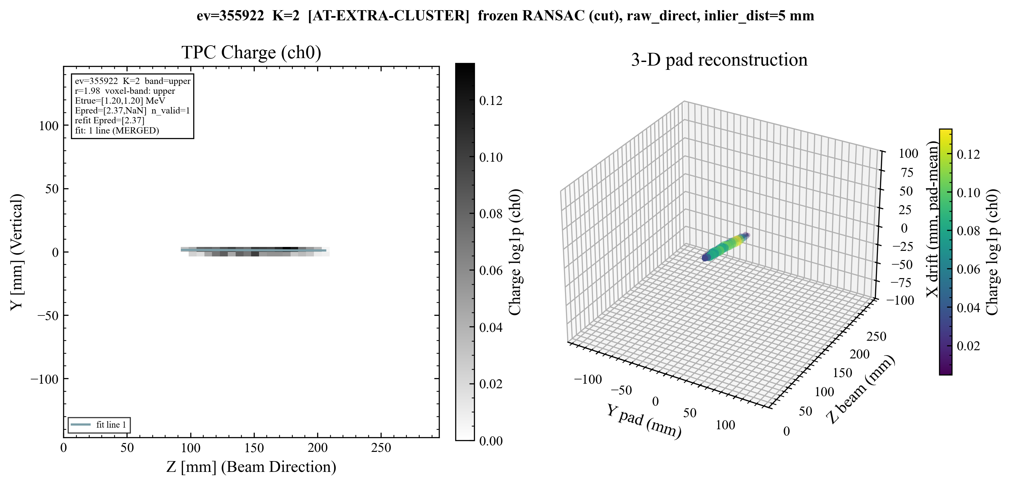
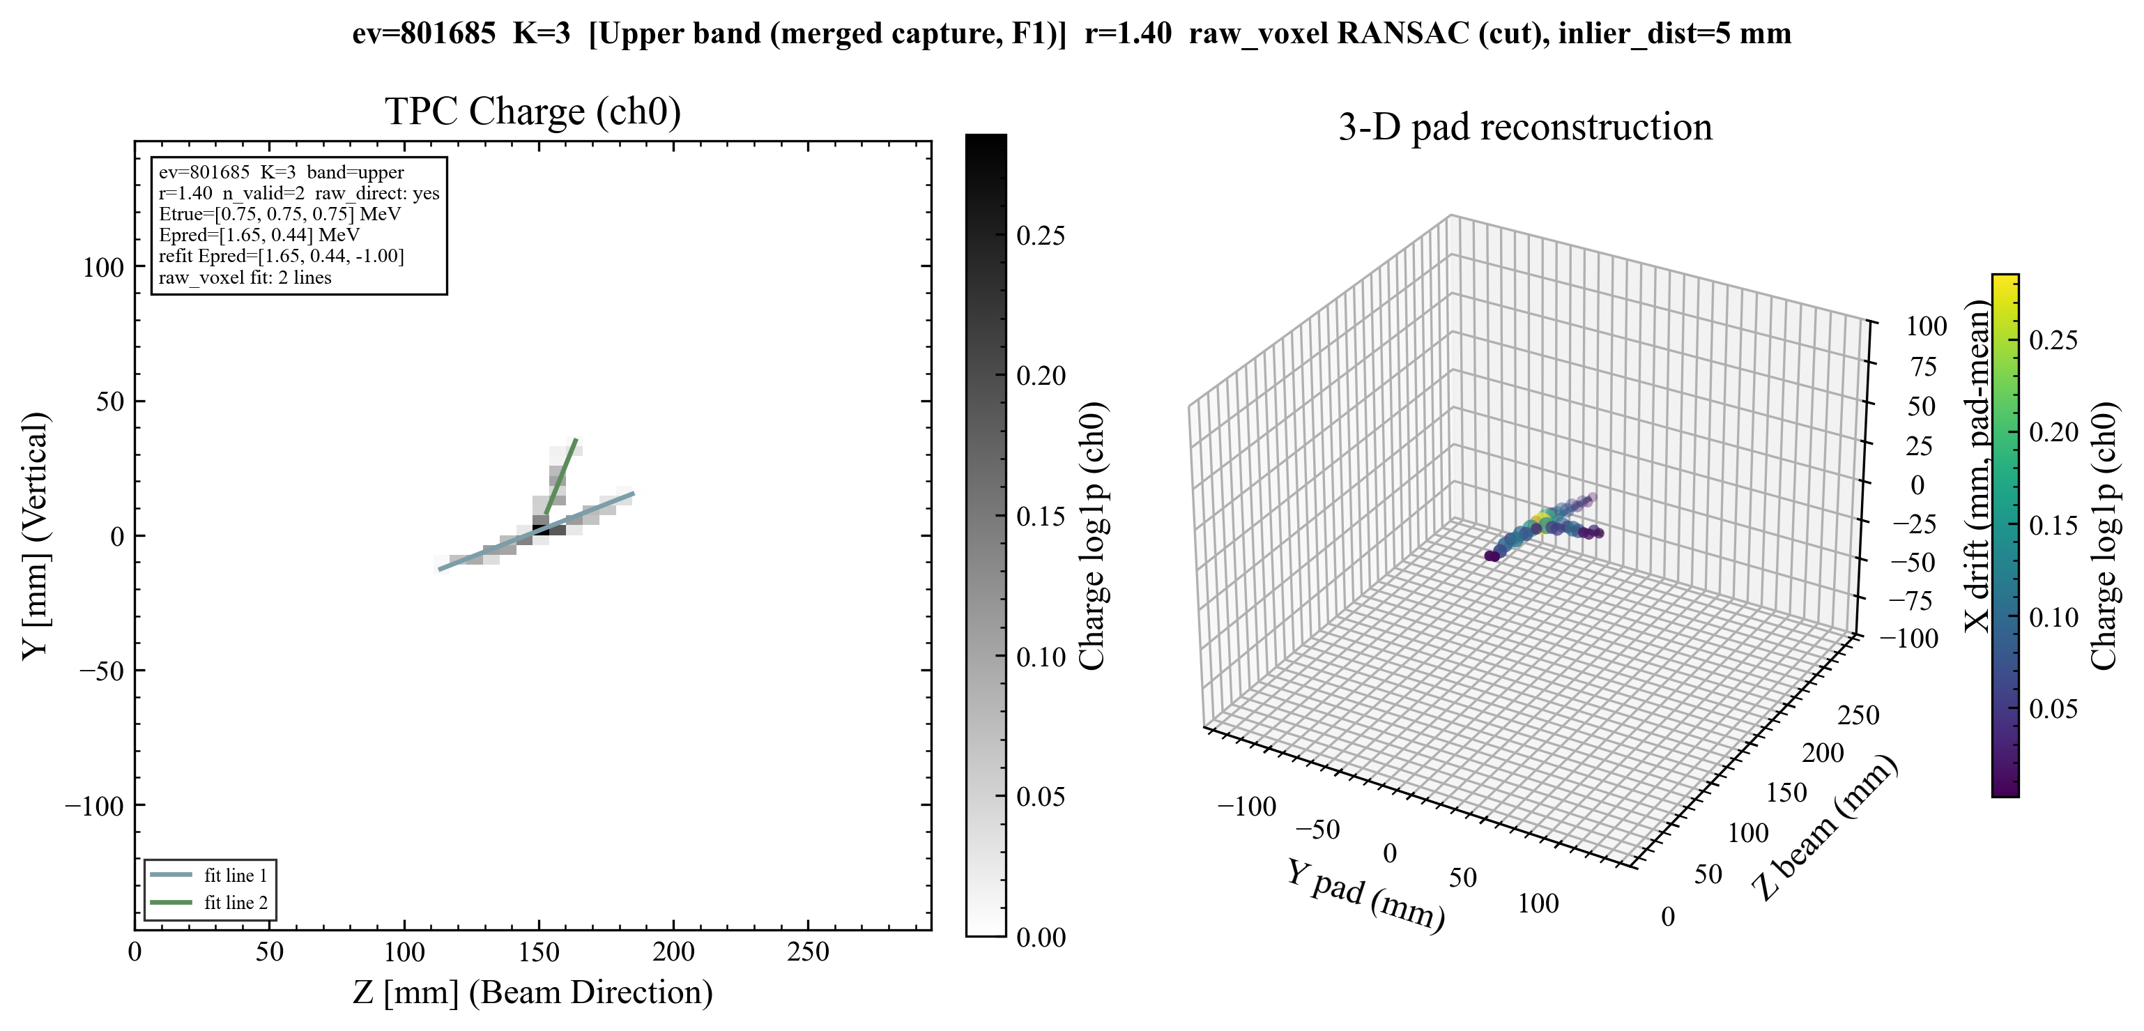
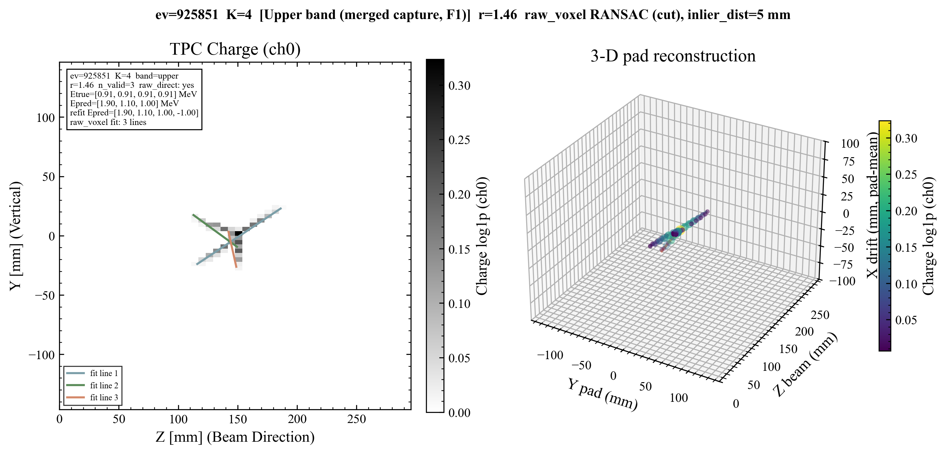
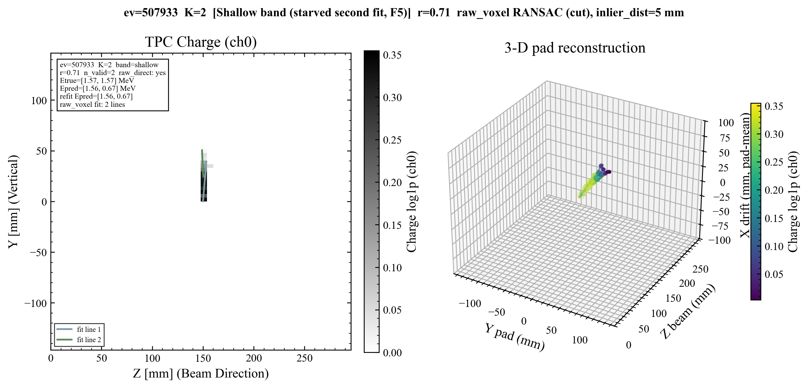
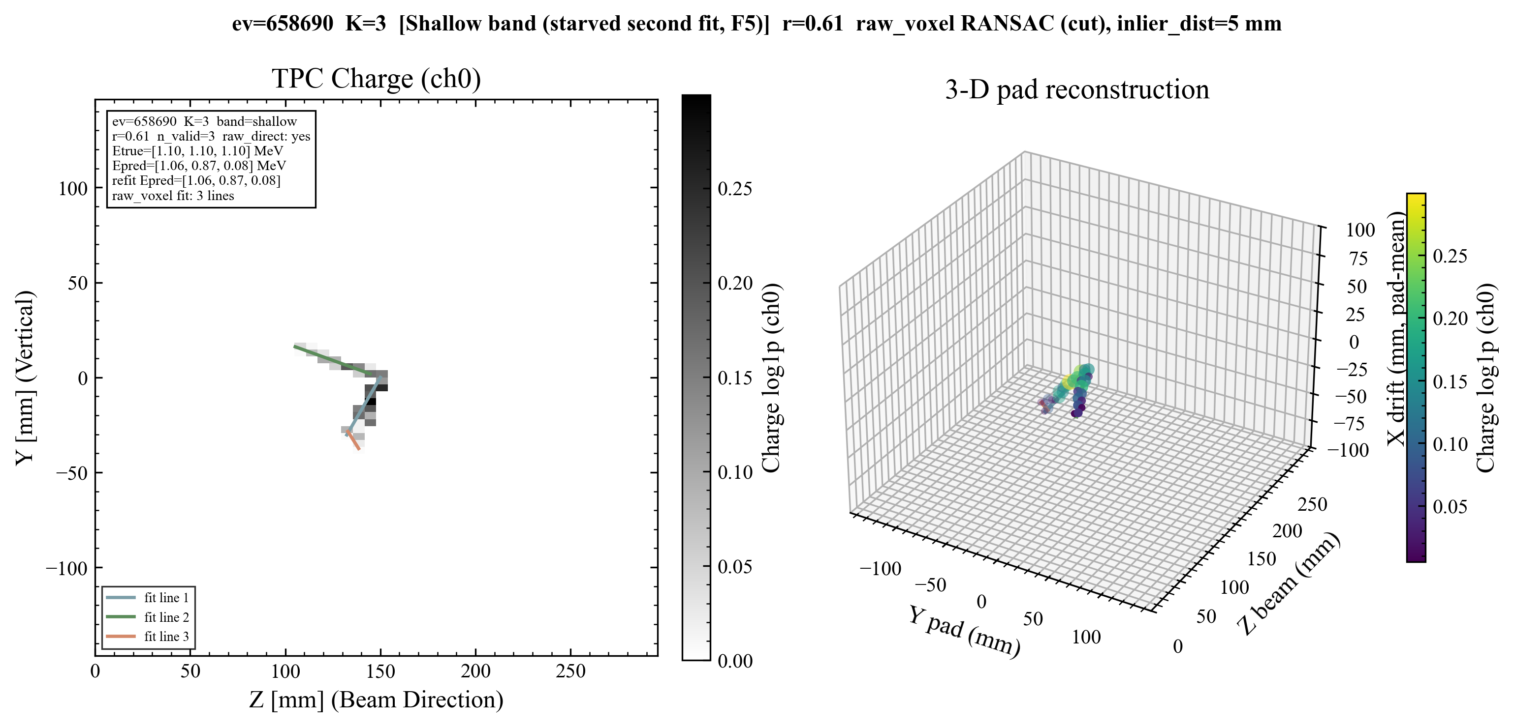
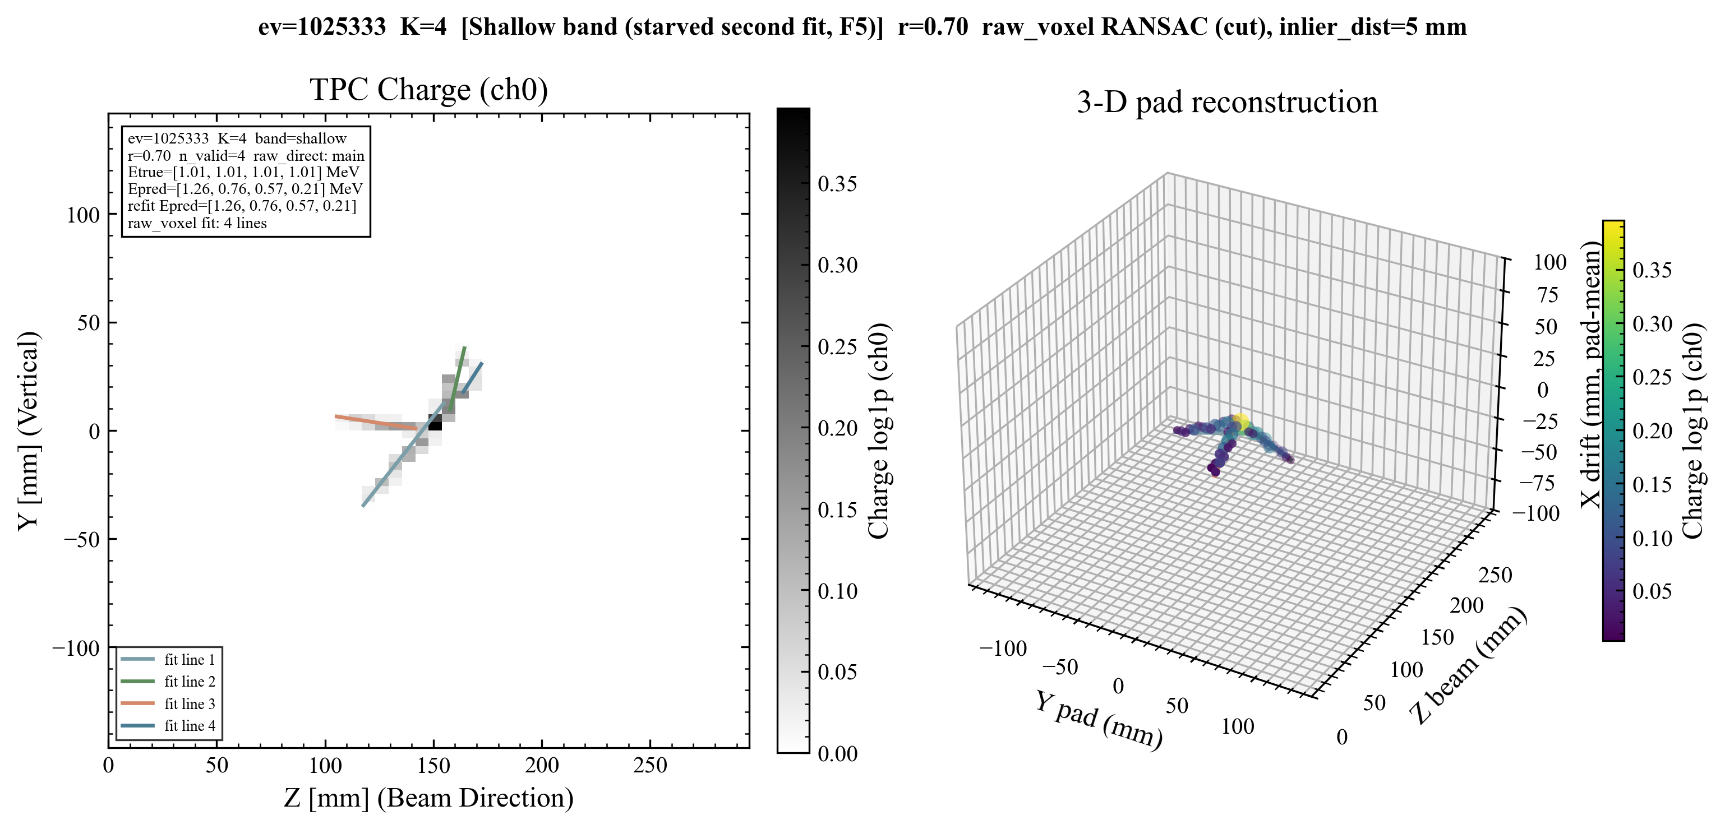
Anomaly Visualization
Upper band K = 2
Quantity: 1010 (2.24%)
Upper band K = 3
Quantity: 2478 (5.51%)
Upper band K = 4
Quantity: 2694 (5.99%)
Shallow band K = 2
Quantity: 1366 (3.04%)
Shallow band K = 3
Quantity: 1285 (2.86%)
Shallow band K = 4
Quantity: 687 (1.53%)
Energy regression
5 / 10

Slide 6
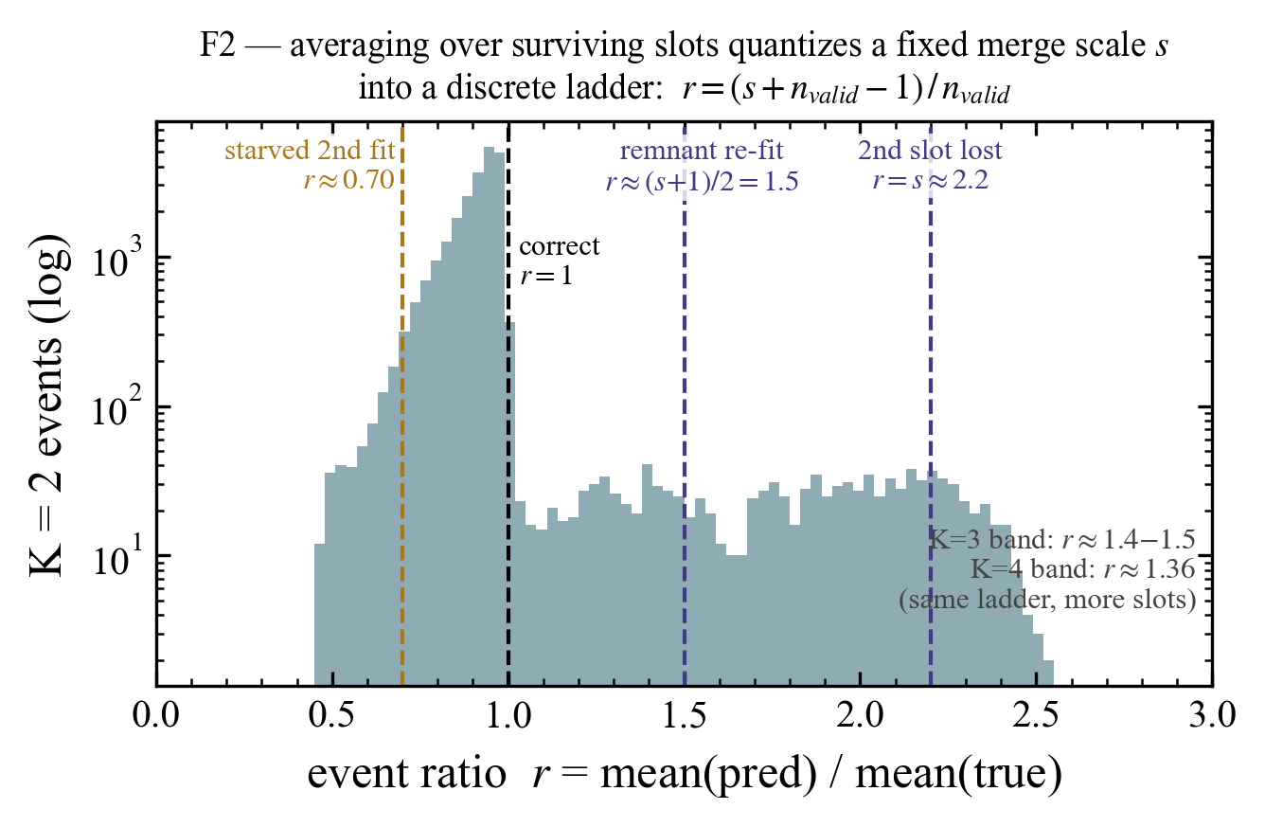
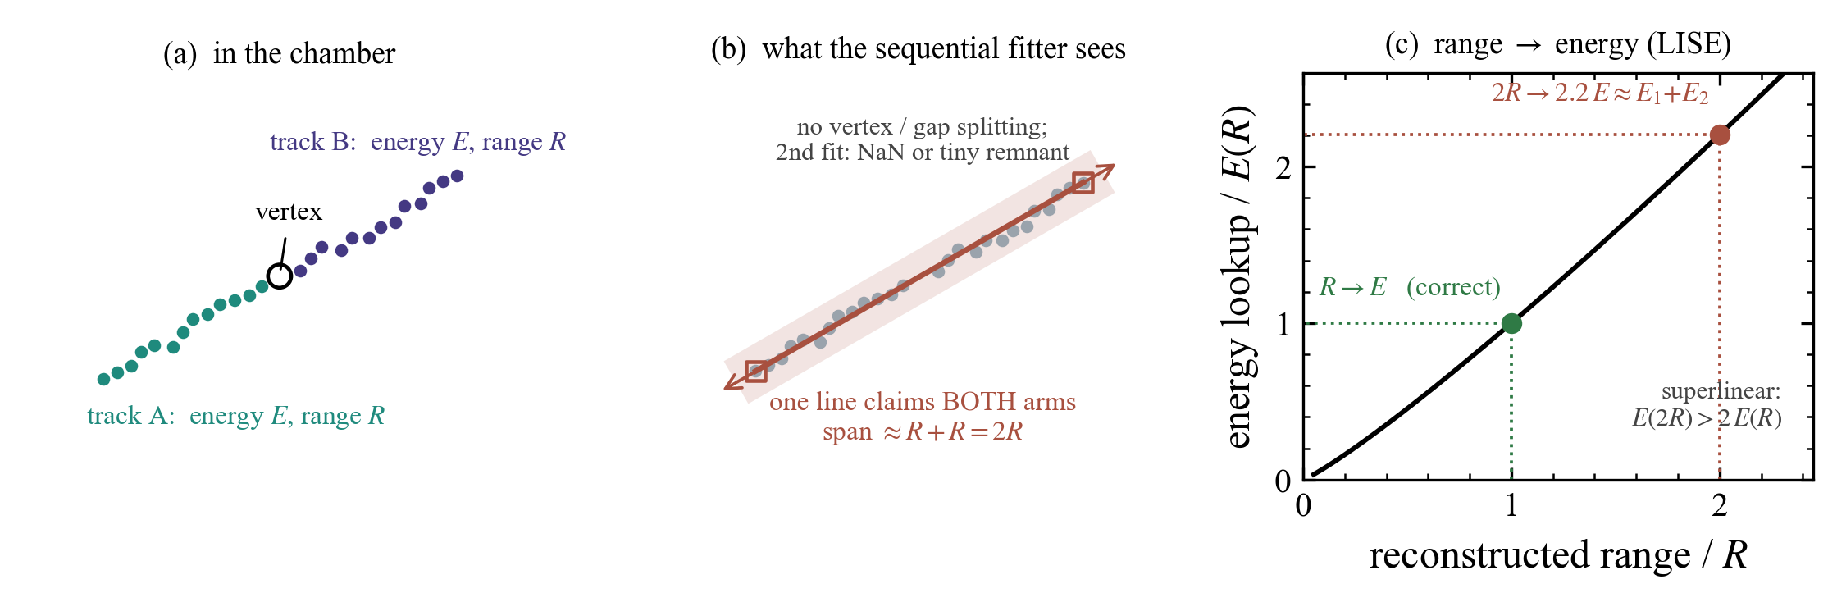
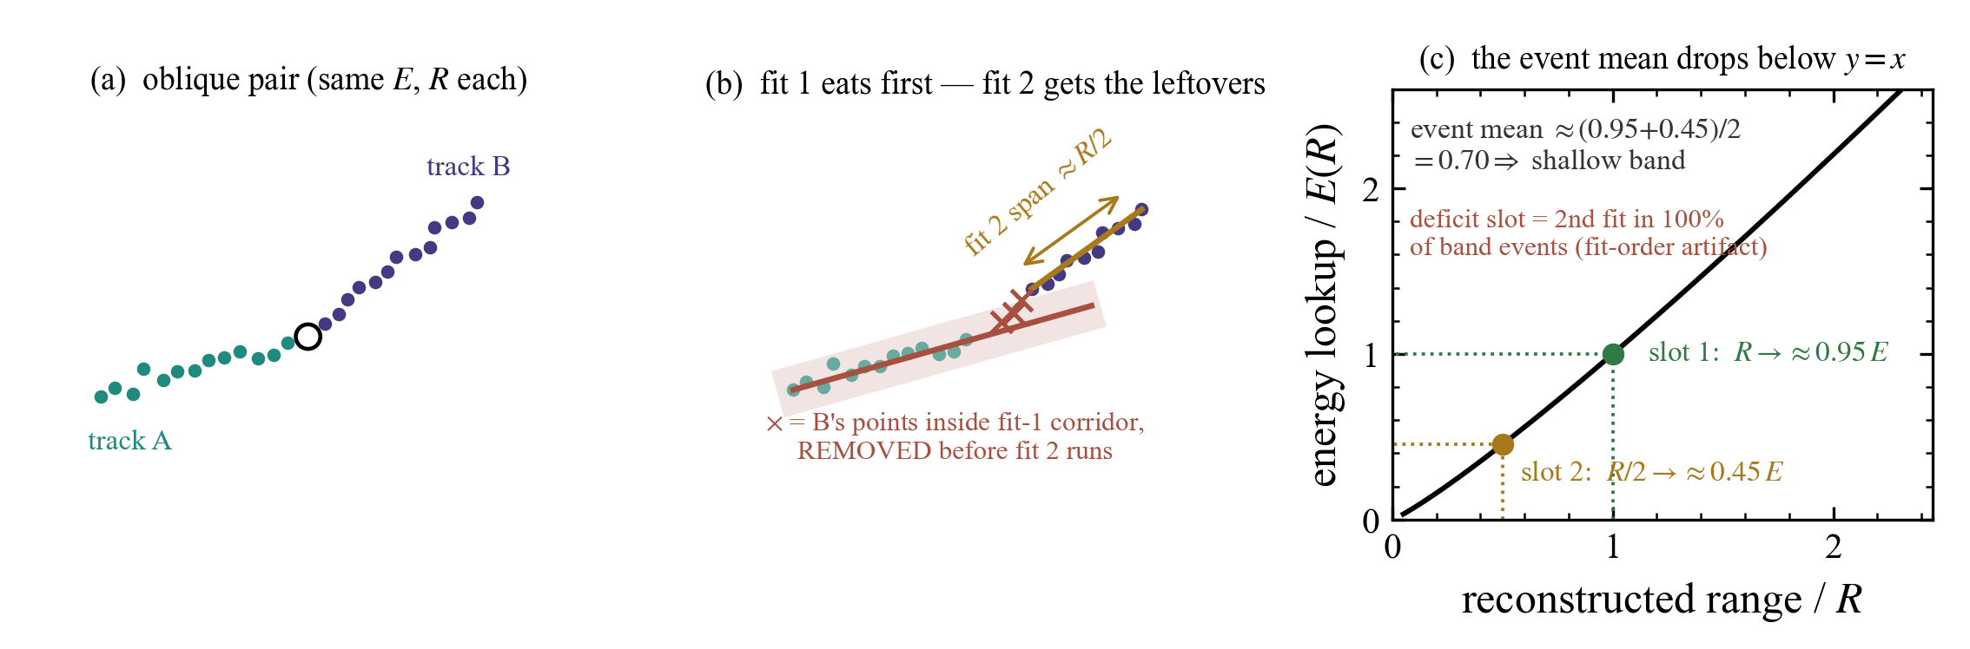
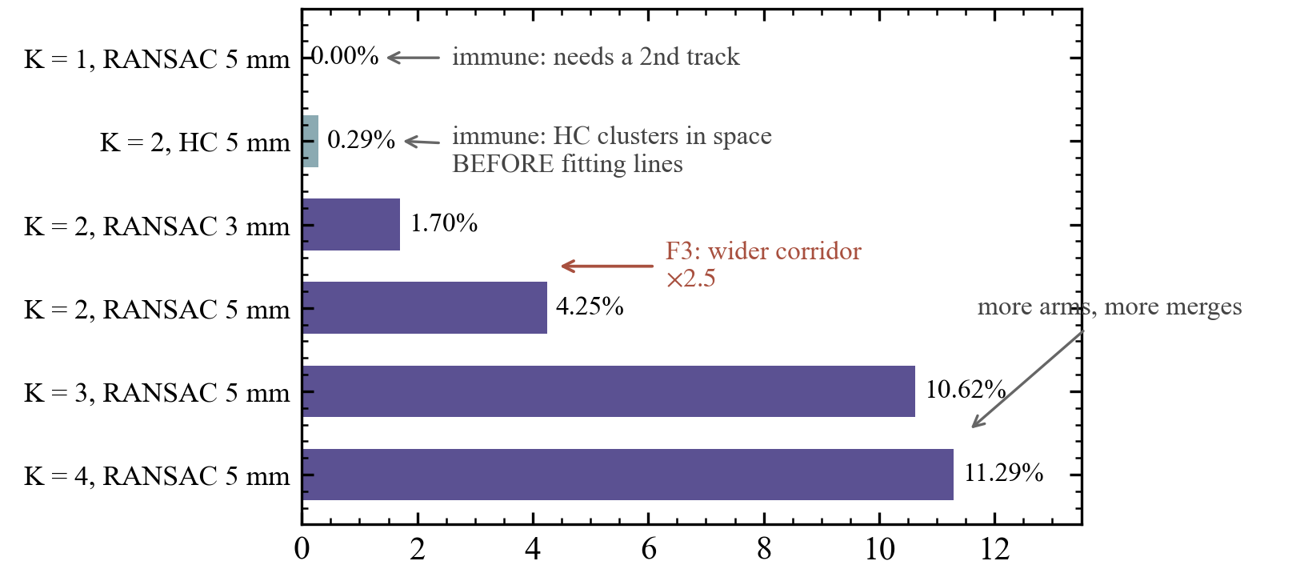
Anomaly Analysis
A back-to-back pair is fitted as one track upper band
Quantization and Verification
Fit 1’s corrider occupies Fit 2’s vertex-proximal shallow band
Energy regression
6 / 10

Slide 7
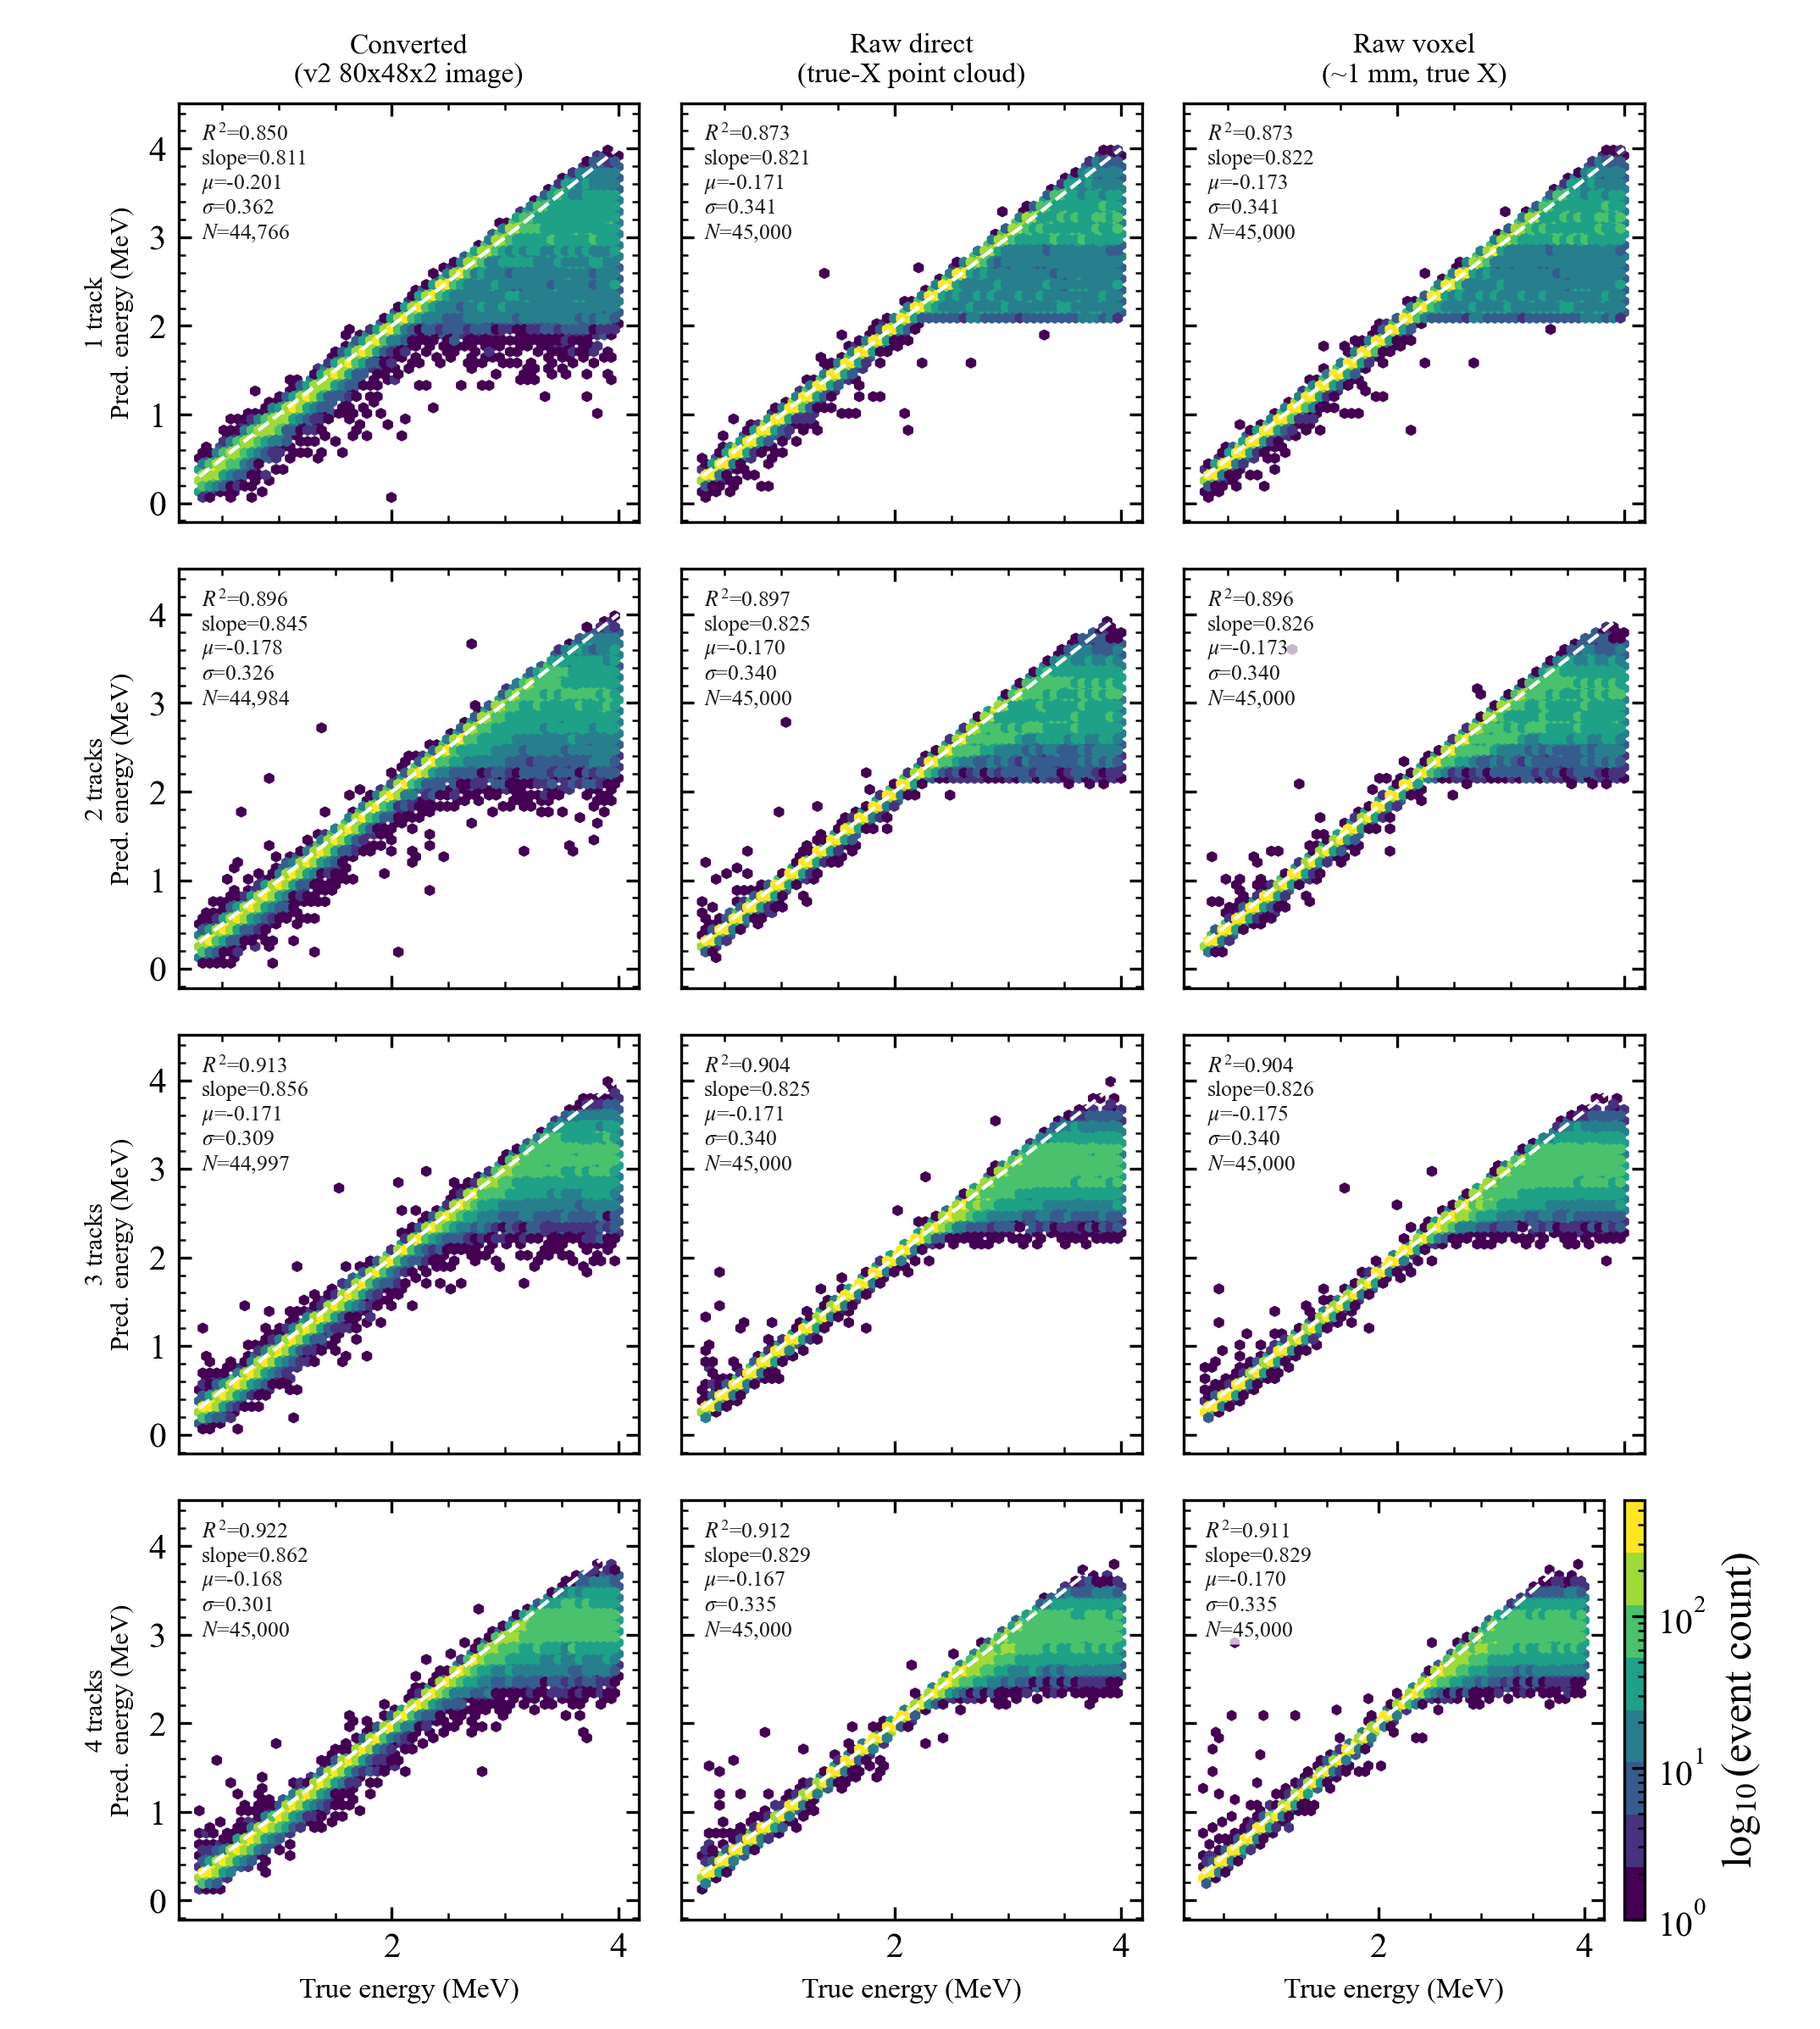
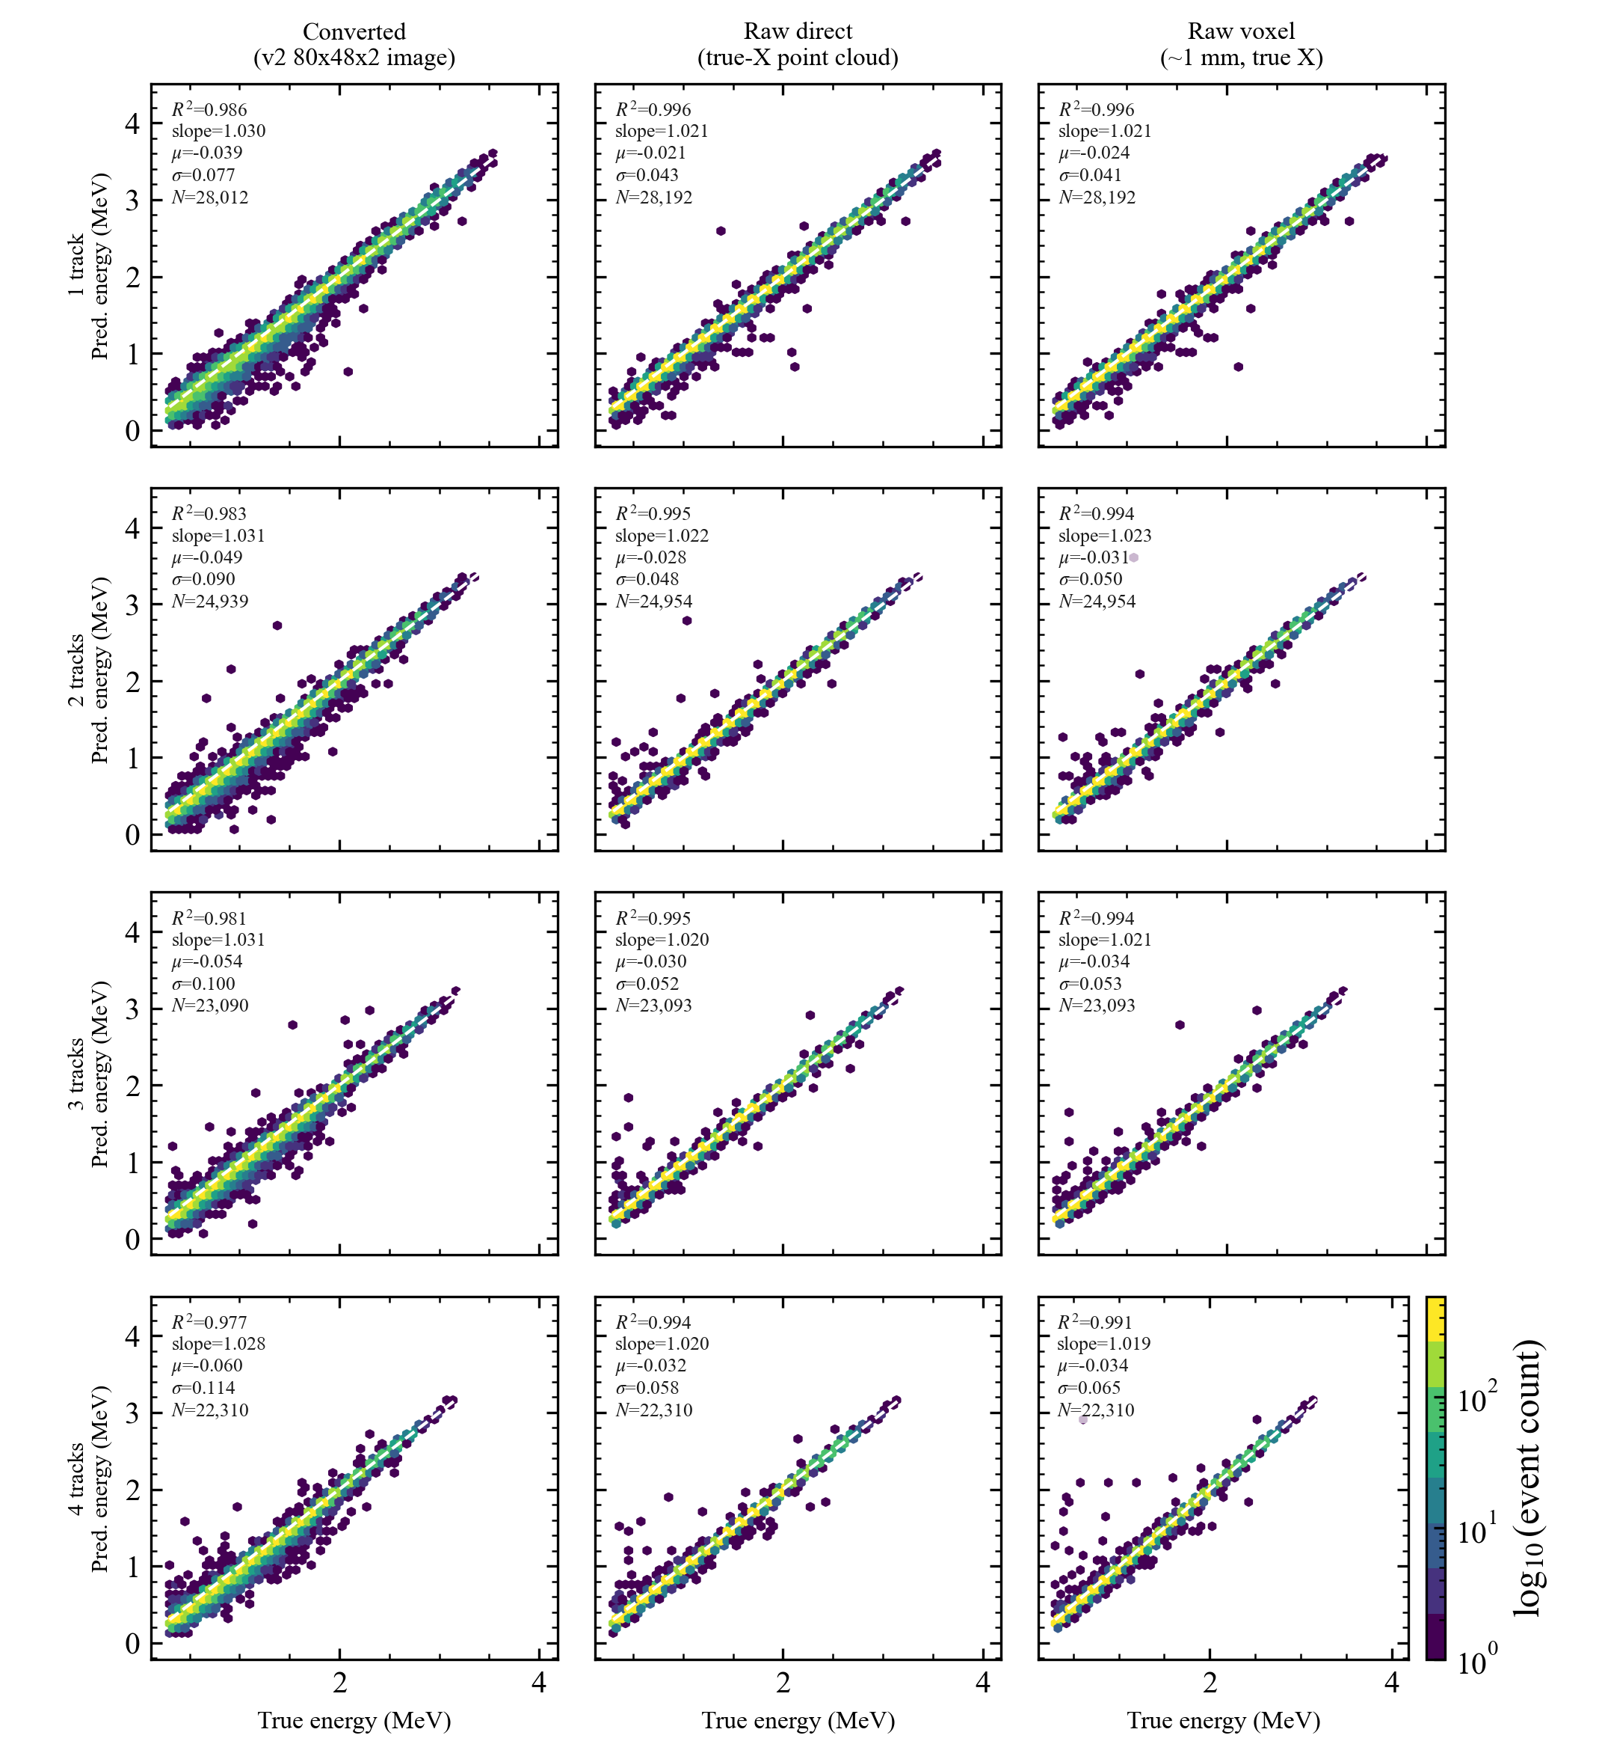
After Rectification
Energy regression
7 / 10

Slide 8
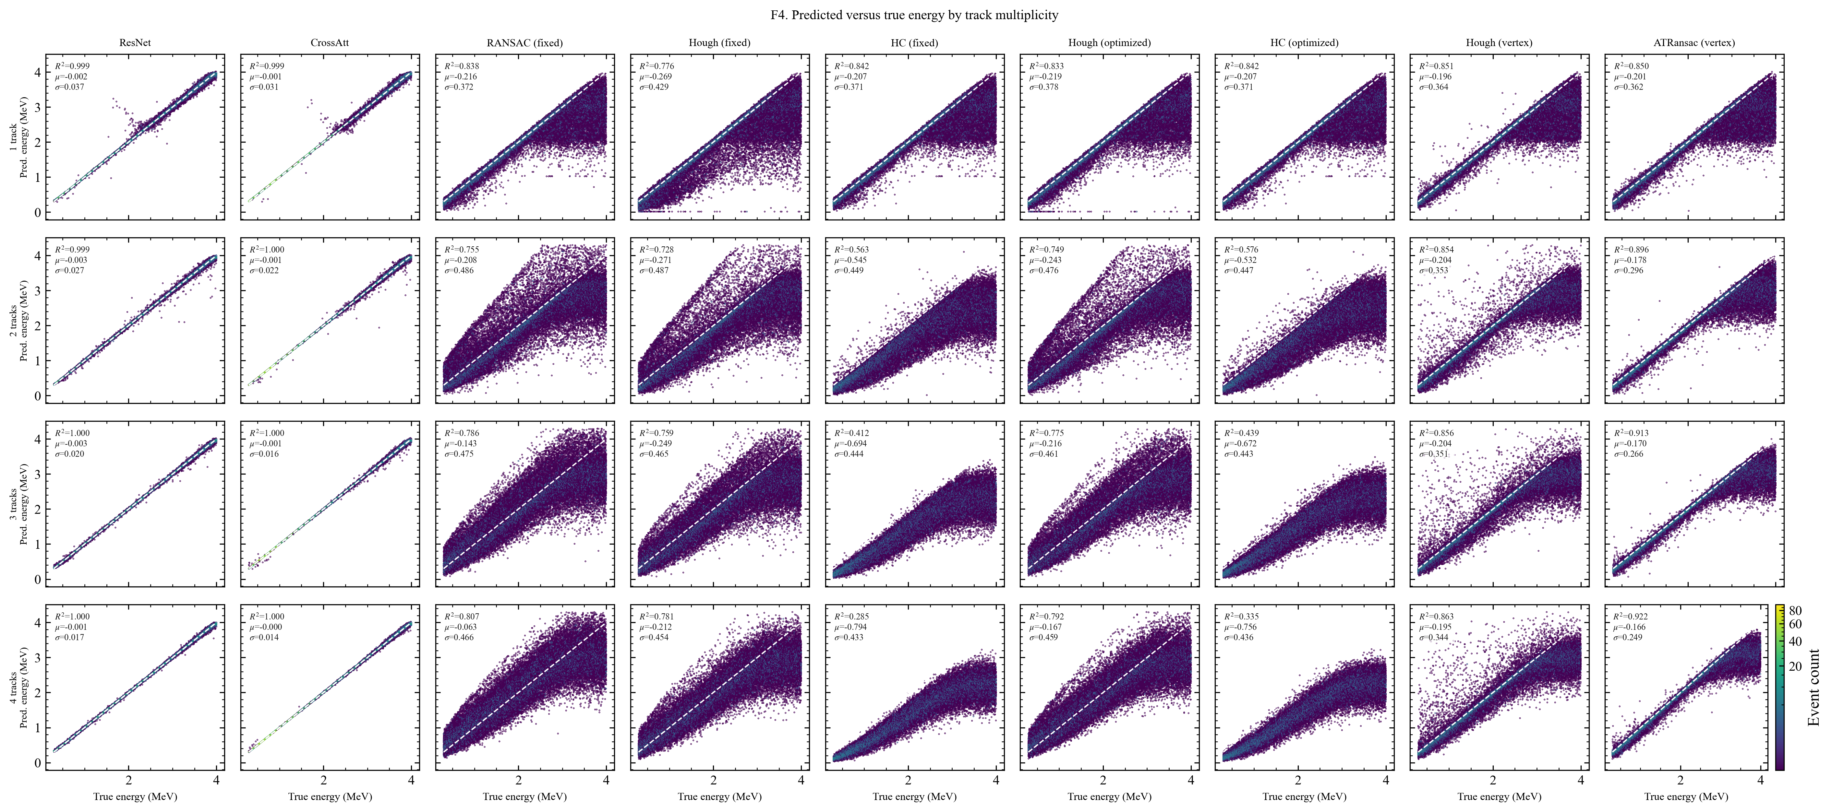
Comparison of Hough
This is the anomaly investigation and inference for RANSAC only.
The corresponding investigation for Hough is still in progress.
Energy regression
8 / 10

Slide 9
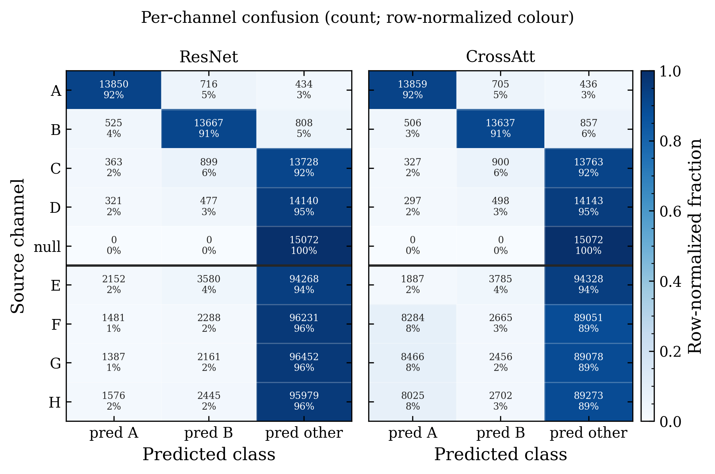
Result of Unseen Channel Experiment
CHANNEL | REACTION
A | ¹²C(α,p)
B | ¹²C(α,d)
C | ¹²C(α,t)
D | ¹²C(α,³He)
null | empty detector
E | ¹²C(α,⍺) elastic
F | ¹³C(α,α) elastic
G | ¹⁴C(α,α) elastic
H | ¹²C(¹²C,¹²C) elastic
Data-scarce
Energy regression
9 / 10

Slide 10
Nest Steps
1. Discuss on how to implement Hough with LiLu
2. Manuscript Drafting
3. Discuss on whether it is necessary to add more new work
Energy regression
10 / 10

